Slide 1
Short Story Second Year Classes
Assist.Prof. Asmaa. Mukaram. Saeed

Slide 2
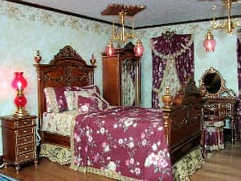
The Doll’s House by Katherine Mansfield

Slide 3
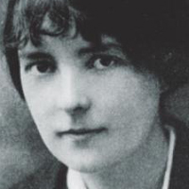
Katherine Mansfield

Slide 4
In The Doll’s House by Katherine Mansfield we have the theme of class, prejudice, connection, hope, appearance and equality.
Taken from her The Doves’ Nest and Other Stories collection the story is narrated in the third person by an unnamed narrator and after reading the story the reader realises that Mansfield may be exploring the theme of class.

Slide 6
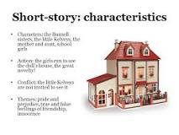
The central theme in Katherine Mansfield's short story "The Doll's House" concerns the inhumanity of social class discrimination and the hope for the dawn of a new day bringing true equality.Mansfield grew up in British colonial New Zealand, and her short story, as well as many of her other works, reflect her own ...

Slide 7
Metaphor:
The very title of the story is very ironical. It is comparison of a small toy with that of a perfect house. Doll’s house in way is the show of human cruelty and differences within themselves. There are some people who even do not have shelter and food. On the other hand some are busy in their perfection without noticing the deprived section of society.
Simile:
Similes are used in different places in the story to compare certain necessary ideas. Description of the house is very important in the story. ‘The door, gleaming with yellow warmth, was like a slab of toffee”, is the description of the house. This shows that every part the house is very important for children. One of main reason for comparing door with that of toffee, is the nature of children. Children generally love sweets. Thus by comparing door with sweets it show that children are attracted by this house.

Slide 8
Personification:
Personification is used to show importance of some non-human thing. Lamp is considered as a very precious and important from the perspective of Kezia.
“The lamp was perfect. It seemed to smile to Kezia, to say “I live here”. The lamp was real”.
symbolism:
Symbolism is another figure of speech that adds magical tone to the story.
The most important is the Dolls house, which shows that how children are interested in house. But on symbolic level it is a satire on society that how rich are socially separating poor. They torture and harm them, even they do not allow them to visit their dolls house.
Lamp is another important symbol in the story. It symbolizes hope because it brings light to the room. It also symbolizes guidance as lamp can throw light in everyone without any discrimination of poor and rich.

Slide 10
