Slide 1
Simple Sentence
BY
DR. BUSHRA NI’MA

Slide 2
NEGATION
BASIC INFORMATION

Slide 3
GENERAL TYPES OF NEGATION
CLAUSE NEGATION – the whole clause is syntactically treated as negative:
She’s not an attractive woman in any respect(, is she?)
LOCAL NEGATION – one constituent (but not necessarily a clause element) is negated:
She’s a not unattractive woman in some ways. (NOT: in any respect)
PREDICATION NEGATION – very rare, applies only after certain auxiliaries (often depends on pronunciation):
They may not go swimming. [=They are allowed not to go swimming]
NEGATION IS REALIZED THROUGH USE OF NEGATIVE ITEMS.

Slide 4
NEGATION via NEGATIVE ITEMS
The clause can be negated:
EITHER BY NEGATING THE VERB,
OR BY NEGATING OTHER SENTENCE ELEMENTS.
Depending on what sentence element is being negated, it is necessary to use different negative items:
VERB NEGATION: the negative particle NOT is always used: He does not diging. She is not a model wife.
NEGATION OF OTHER SENTENCE ELEMENTS can be achieved using DIFFERENT NEGATIVE ITEMS:
Words negative in form and meaning: no, none, never, not
Word negative in meaning only (not negative in form): rarely, seldom, scarcely, barely, little, few
VERBS, ADJECTIVE, PREPOSTIONS with IMPLIED NEGATIVE MEANING: refuse, deny, fail; reluctant, unaware; without, against; unless

Slide 5
NEGATION: SCOPE OF NEGATION
The SCOPE OF NEGATION is the stretch of language OVER WHICH THE NEGATIVE MEANING OPERATES AND WHERE NON-ASSERTIVE ITEMS MUST BE USED.
The SCOPE OF NEGATION EXTENDS FROM THE NEGATIVE ITEM TO:
THE END OF THE CLAUSE (NOT NECESSARILY THE END OF THE SENTENCE),
THE END OF THE NEGATED PHRASE (IF ONLY A SINGLE PHRASE IS NEGATED), OR
THE BEGINNING OF THE FINAL ADJUNCT.
WHY IS THIS SUCH A BIG DEAL?
The POSITION OF THE NEGATIVE ITEM may drastically INFLUENCE THE MEANING OF THE WHOLE SENTENCE:

Slide 6
SCOPE OF NEGATION
She definitely didn’t speak to him.
= It is definite that she didn’t speak to him.
She didn’t definitely speak to him.
= It is not definite that she spoke to him.

Slide 7
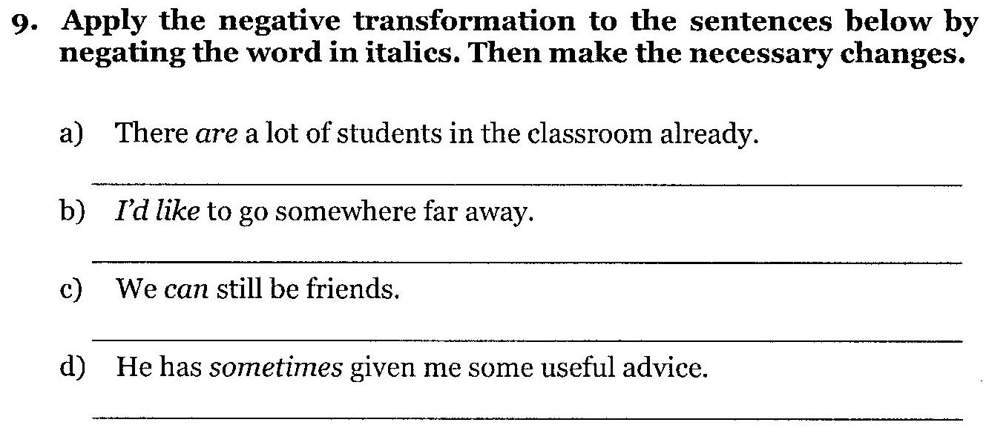
PAGE 145 – exercise 9 (a-d)
THERE AREN’T ANY STUDENTS IN THE CLASSROOM YET.
I WOULDN’T LIKE TO GO ANYWHERE FAR AWAY.
WE CANNOT BE FRIENDS ANY MORE/ANY LONGER.
HE HAS NEVER/RARELY GIVEN ME ANY USEFUL ADVICE.

Slide 8
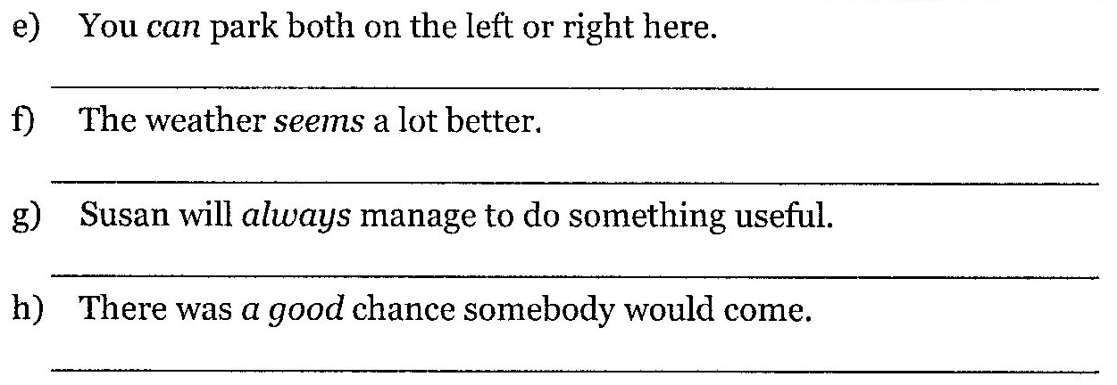
PAGE 145 – exercise 9 (e-h)
YOU CAN’T PARK EITHER ON THE LEFT OF RIGHT HERE.
THE WEATHER DOESN’T SEEM ANY BETTER.
SUSAN WILL NEVER MANAGE TO DO ANYTHING USEFUL.
THERE WAS NO CHANCE ANYBODY WOULD COME.

Slide 9
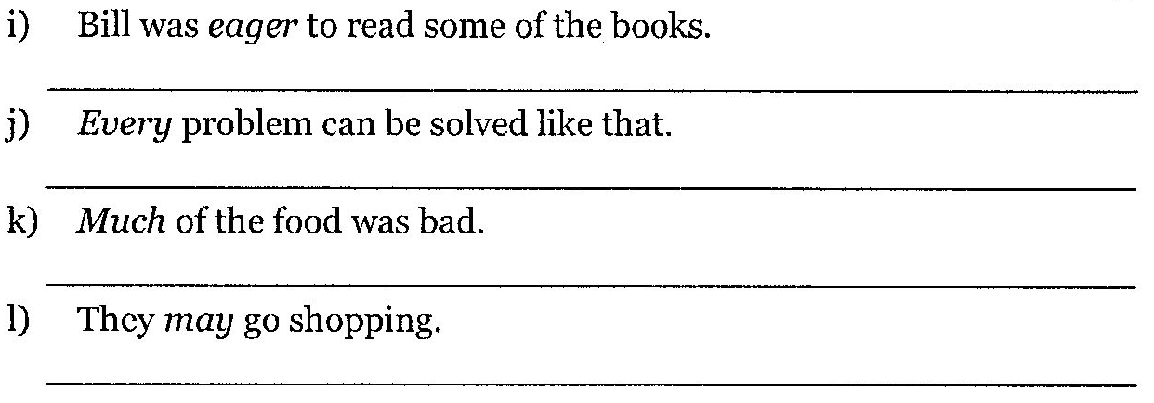
PAGE 145 – exercise 9 (i-l)
BILL WAS UNENTHUSIASTIC TO READ ANY OF THE BOOKS.
NO PROBLEM CAN BE SOLVED LIKE THAT.
LITTLE OF THE FOOD WAS BAD.
THEY WON’T GO SHOPPING.

Slide 10
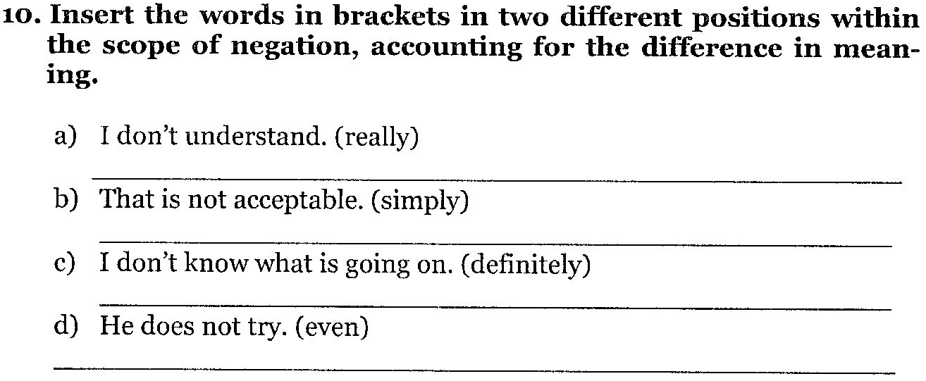
PAGE 146 – exercise 10
(REALLY,) I (REALLY) DON’T (REALLY) UNDERSTAND.
THAT (SIMPLY) IS (SIMPLY) NOT ACCEPTABLE.
I (DEFINITELY) DON’T (DEFINITELY) KNOW (DEFINITELY) WHAT ….
(EVEN) HE (EVEN) DOESN’T (EVEN) TRY (EVEN).

Slide 11
SENTENCE TYPES AND DISCOURSE FUNCTION
BASIC INFORMATION

Slide 12
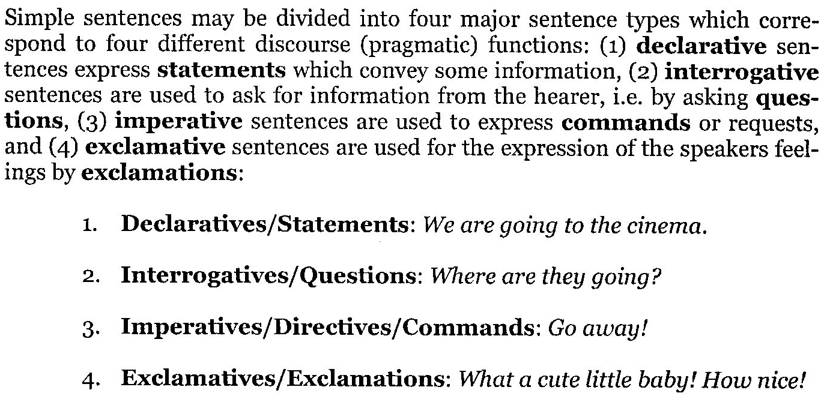
Sentence types and discourse functions

Slide 13
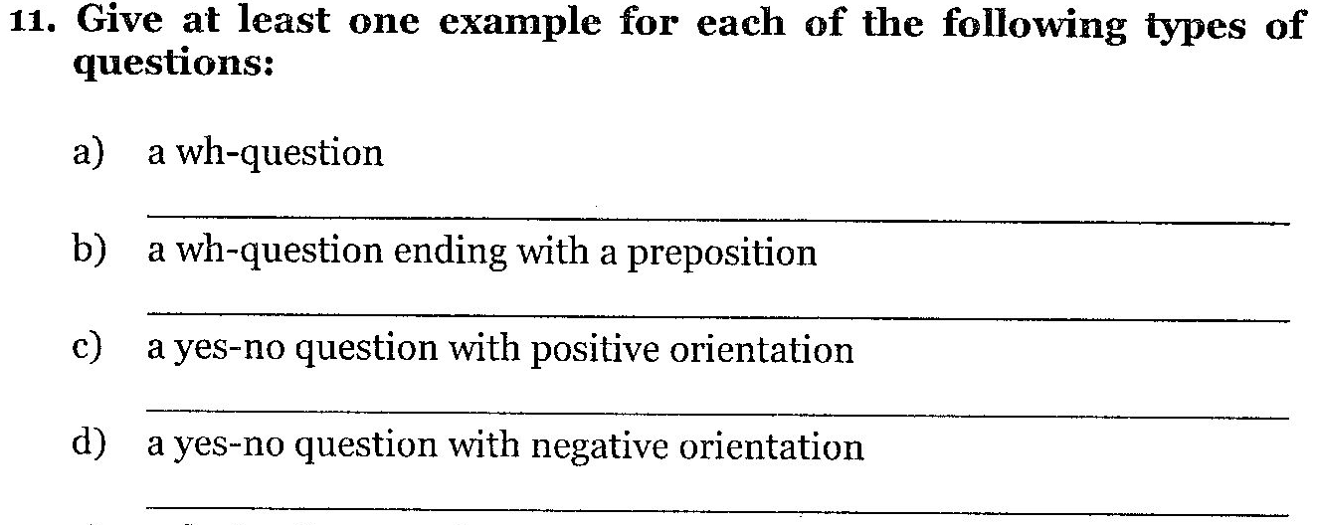
PAGE 146 – exercise 11 (a-d)
WHAT IS HER NAME?
WHERE DOES SHE COME FROM?
DID SOMEONE CALL HER LAST NIGHT?
CAN’T YOU GIVE US ANY HELP?

Slide 14
PAGE 146 – exercise 11 (e-h)
YOU’VE GOT YOUR CAMERA WITH YOU?
SHALL WE TRAVEL BY BUS OR TRAIN?
HASN’T SHE GROWN!
IS THAT A REASON FOR DESPAIR?

Slide 15
THE END
Thank you for your time!

