Slide 1
Short story Second Year classes
Assist.Prof.Asmaa.Mukaram .Saeed

Slide 2
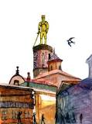
The Happy Prince by Oscar Wilde

Slide 3
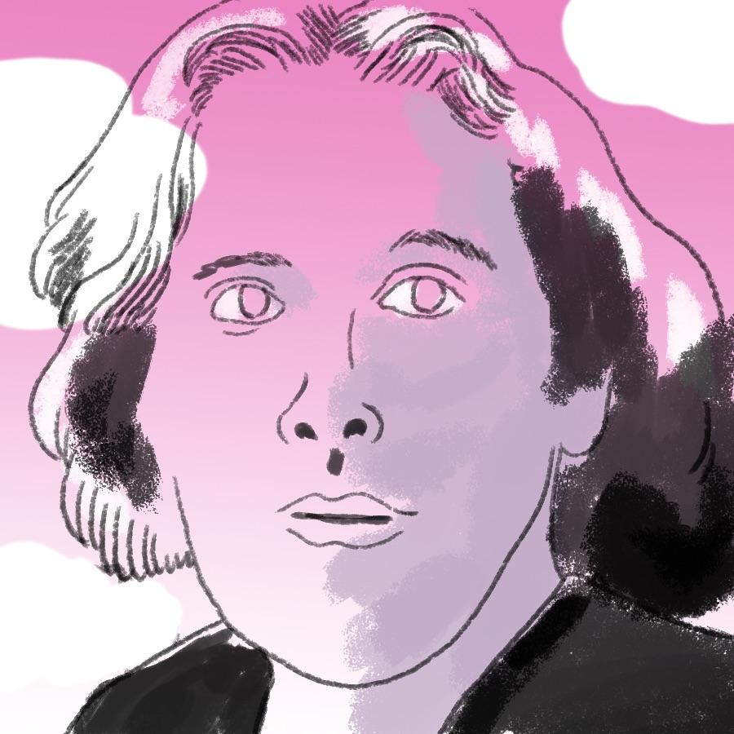
Oscar Wilde

Slide 4
The story is allegorical to the social class system of Victorian England—the wealth of the upper classes versus the impoverishment of the poor. The statue of the prince has its jewels delivered to the poor via the swallow (now, on top of the hill, the prince can see the poverty that had previously been shielded from him).
Eventually the statue loses all its material wealth; he is richer inside for helping the needy, but no longer outside, and the swallow dies. The people remove the prince statue, now that he is plain, and discuss the next statue that will replace him, because material wealth is most important to them.

Slide 5
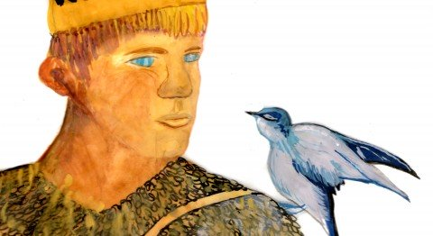
Oscar Wilde's story of a statue and a swallow is both beautiful and sad. We feel it captures much of the spirit of Easter (our reasons for thinking this are explained here). The statue was once a prince, who enjoyed a life of pleasure. He had no idea that anybody else could be poor or sad. Now that he is a statue, high above the city, he can see that his happiness is not shared by all.

Slide 6
