Slide 1
Short Story Second Year Classes
Assist.Prof.Asmaa.Mukaram.Saeed

Slide 2
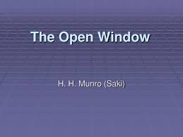
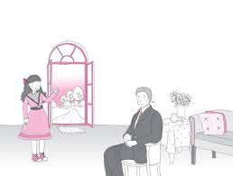

Slide 4
