Slide 1
The sounds of Language / Manner of Articulation BY.NADYA KHAIRY Part.2 نادية خيري محمد سعيد- استاذ مساعد- قسم اللغة الانكليزية

Slide 2
Manner of articulation :
The Manner of articulation describes the sounds in terms of how they are Articulated. Such a description is necessary to differentiate between some sounds, for example we have the /t/ and /s/ sounds how do they differ? They differ in their manner of articulation, that is, in the way they are pronounced. The /t/ sound is one of a set of sounds called the stops and the /s/ sound is one of a set of sounds called fricatives.

Slide 3
1- Stops: These sounds are produced by some form of stopping the air stream (very briefly) then letting it go abruptly, this type of sound resulting from a blocking or stopping effect on the air stream is called a stop (plosive). Ex: /p/, /b/, /t/, /d/, /k/, /g/.
2-Fricatives: The manner of articulation used in producing the set of sounds /f/, /v/, /θ/, /ð/, /s/, /z/, /ʃ/, /3/ involves almost blocking the air steam and having the air push through the very narrow opining.

Slide 4
3- Affricates: If you combine the brief stopping of the air stream with an obstructed release whish cases friction , you will be able to produce sounds /tʃ/ which is voiceless and /dJ/ which is voiced. They are called affricates.
4- Nasals: Most sounds are produced orally, with the velum raised, preventing the airflow from entering the nasal cavity, however when the velum is lowered and the air stream is allowed to flow out through the nose to produce /m/,/n/ and /ŋ/, these sounds are described as Nasals and they are all voiced.

Slide 5
5- Liquids: The initial sounds in the words led and red are described as liquids, they are both voiced, the sound /l/ is called lateral liquid and is formed by letting the air stream flow around the sides of the tongue as the tip of the tongue makes contact with the middle of the alveolar ridge. The /r/ sound is formed with the tongue tip raised and curled back near the alveolar ridge.
6-Glides: The sounds /w/ and /j/ are described as glides. They are both voiced and occur at the beginning of we, wet, you, yes. These sounds are typically produced with the tongue in motion to or from the position of a vowel and are sometimes called semi-vowels.
The /l/, /r/ and /w/, /j/ sounds are sometimes combined in one category called approximants.

Slide 6
Glottal stops and Flaps:
1- The glottal stop: It is represented by the symbol /?/, occurs when the space between the vocal folds ( the glottis which is the gap between the vocal folds) is closed completely (very briefly), then released.
The Flap: It is represented by the /D/ symbol or sometimes by the /r/. This sound is produced by the tongue tip tapping the alveolar ridge briefly.

Slide 7
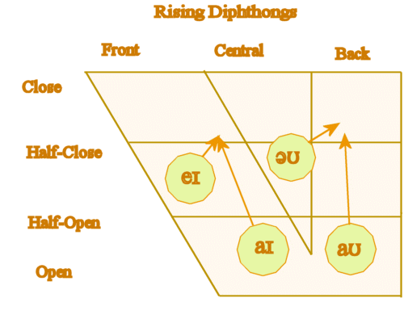
Vowels and Diphthongs:
1-Vowels: while consonant sounds are mostly articulated via closure or obstruction in the vocal tract, vowel sounds are produced with a relatively free flow of air . They are all typically voiced.
2-Diphthongs: In addition to single vowel sounds, we regularly create sounds that consist of a combination of two vowel sounds, known as Diphthongs, when we produce them, our vocal organs move from one vocalic position /a/ to another /I/ producing /aI/. These sounds are : /aI/, /aU/, /eI/, /oU/, /ɔɪ/.

Slide 8
Subtle Individual variation:
Vowel sounds are notorious for varying between one variety of English and the next, often being the key element in what we recognize as different accents.
The most used vowel is English is “Schwa” /ə/, it is the unstressed vowel (underlined) in everyday use of words such as afford , collapse, wanted.

